Slide 1


AI-Guided CBT & Relapse Support
Empowering recovery through scalable, personalized intelligence.

Slide 2


The Mental Health Crisis
Supply & Demand Gap
Accessibility Barriers
The demand for mental health support has skyrocketed, yet there is a critical shortage of qualified therapists. Wait times for care can exceed 3-6 months in many regions.
Traditional therapy is expensive and often requires fixed appointments. Millions fall through the cracks because they cannot access affordable, immediate support during critical moments of need.

Slide 3

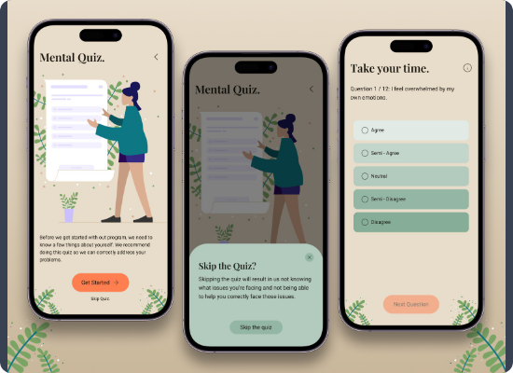
Meet MindAlign
Always-on support, tailored to you.
24/7 AI-CBT: Immediate responses based on clinical protocols.
Relapse Prevention: Predictive modeling identifies triggers before they escalate.
Clinical Escalation: Seamless hand-off to human therapists when high risk is detected.

Slide 4


User Journey
Daily Check-in
AI Analysis
Intervention
Progress
User logs mood or engages in a casual chat.
NLP algorithms analyze sentiment and stress patterns.
System delivers a CBT exercise or coping strategy.
Weekly reports track improvement and adjust the plan.

Slide 5






Tools for Recovery
Empathetic AI
Smart Journaling
Crisis Safety Net
Natural language processing trained on thousands of clinical interactions.
Guided prompts that help users reframe negative thought patterns.
Real-time detection of harm keywords triggers immediate human escalation.

Slide 6




Market Opportunity
Global mental health & addiction market
Digital mental health solutions
AI-guided CBT / relapse support
(MindAlign focus)
Demand for scalable support is soaring.
Users are comfortable with chat and apps.
Employers seek cost-effective solutions.

Slide 7






Business Model
D2C Freemium
B2B Enterprise
Payer Integration
Free: Basic mood tracking & journaling.
Premium ($12/mo): Unlimited AI chat, advanced analytics, and CBT modules.
Licensing deals with University Counseling Centers and EAPs (Employee Assistance Programs) to cover large populations.
Future roadmap involves reimbursement codes through major health insurance providers as a digital therapeutic.

Slide 8
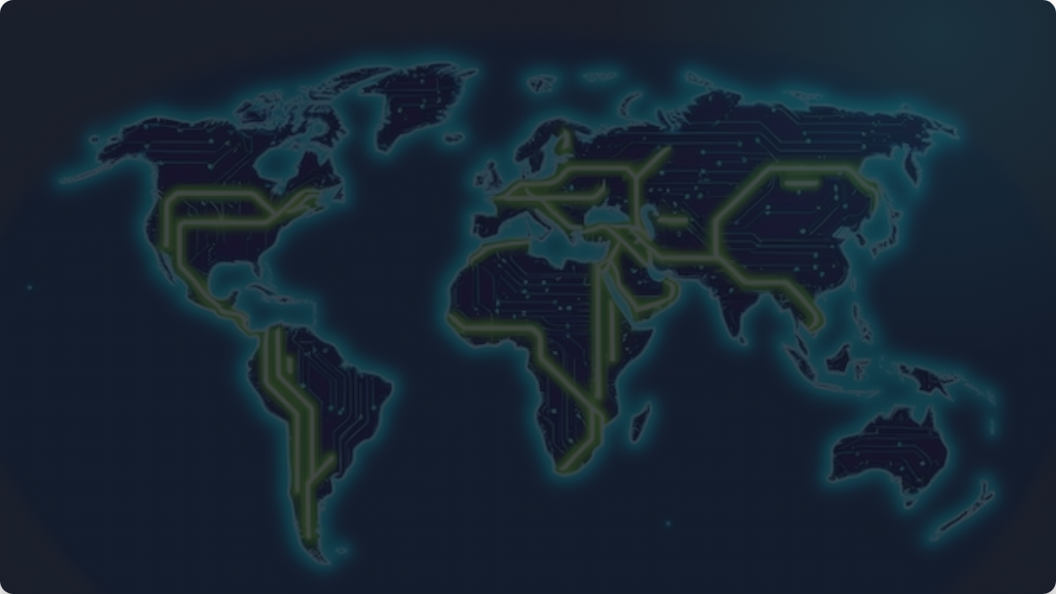
Built on Secure Technology
Our proprietary NLP models are HIPAA-compliant and encrypted end-to-end, ensuring that user data remains private and secure while delivering clinical-grade support.

Slide 9


Questions?
Thank you for your time.
partnerships@mindalign.com
www.mindalign.com

Slide 10



Image Sources
https://i.redd.it/mental-health-app-full-practice-need-feedback-v0-gaxlc7twfvbd1.jpg?width=1600&format=pjpg&auto=webp&s=8259e5126d5399cc9110528505ec4cb3ca203b13
Source: www.reddit.com
https://images.stockcake.com/public/6/a/6/6a6c0108-ef7a-4997-989a-c40b6e20743f_large/diverse-team-smiling-stockcake.jpg
Source: stockcake.com
https://img.freepik.com/premium-photo/abstract-network-technology-background-with-dots-lines-white-canvas-representing-ai-systems-digital-connectivity-data-flow-clean-modern-minimalist-design_713562-39621.jpg
Source: www.freepik.com

